Slide 1
Rural Health Assistant

Slide 2
Business understanding
Our idea is to help people living in settlements far away from the cities where there are no hospitals or doctors and through our artificial intelligence they can check for themselves if it is possible to have any of the mentioned diseases

Slide 3
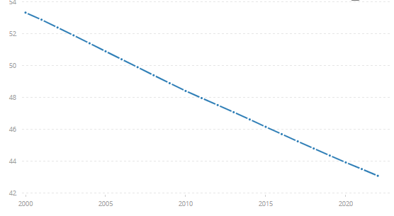
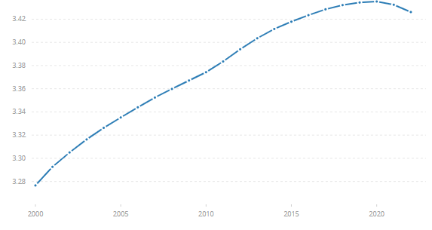
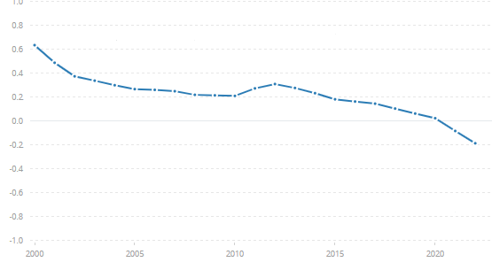
Data understanding and preparation
Rural population (% of total population)
We took the information we will use for training our artificial intelligence from the site:​
World bank​
Rural population
Rural population growth

Slide 4
How we can help you
If you think you might have any health problem, our app will help you. All you need is to enter detail about you. We are not doctors and if the problem is not so serious we will give you recommendations, but if it is the best way is to go to a doctor.

Slide 5
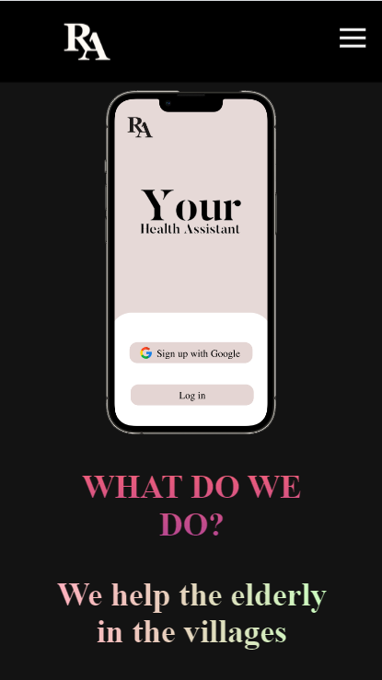
Our mission
Our mission is to support the health of the elderly in the villages, who do not have access to nearby medical centers

Slide 6
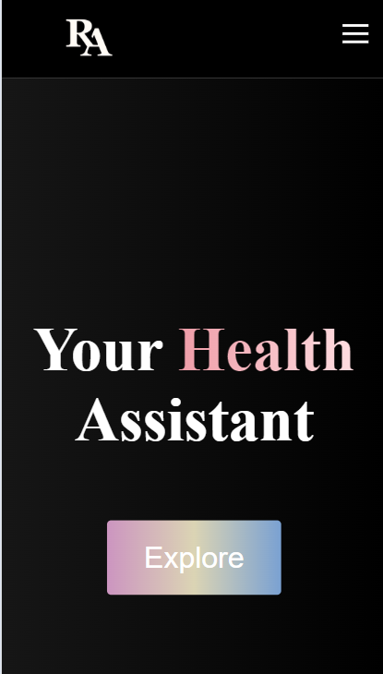
Evaluation
Our business model successfully achieves business goals. There is no important business issue in it.
The data we extracted helps us understand how many people from the villages need our idea.

Slide 7
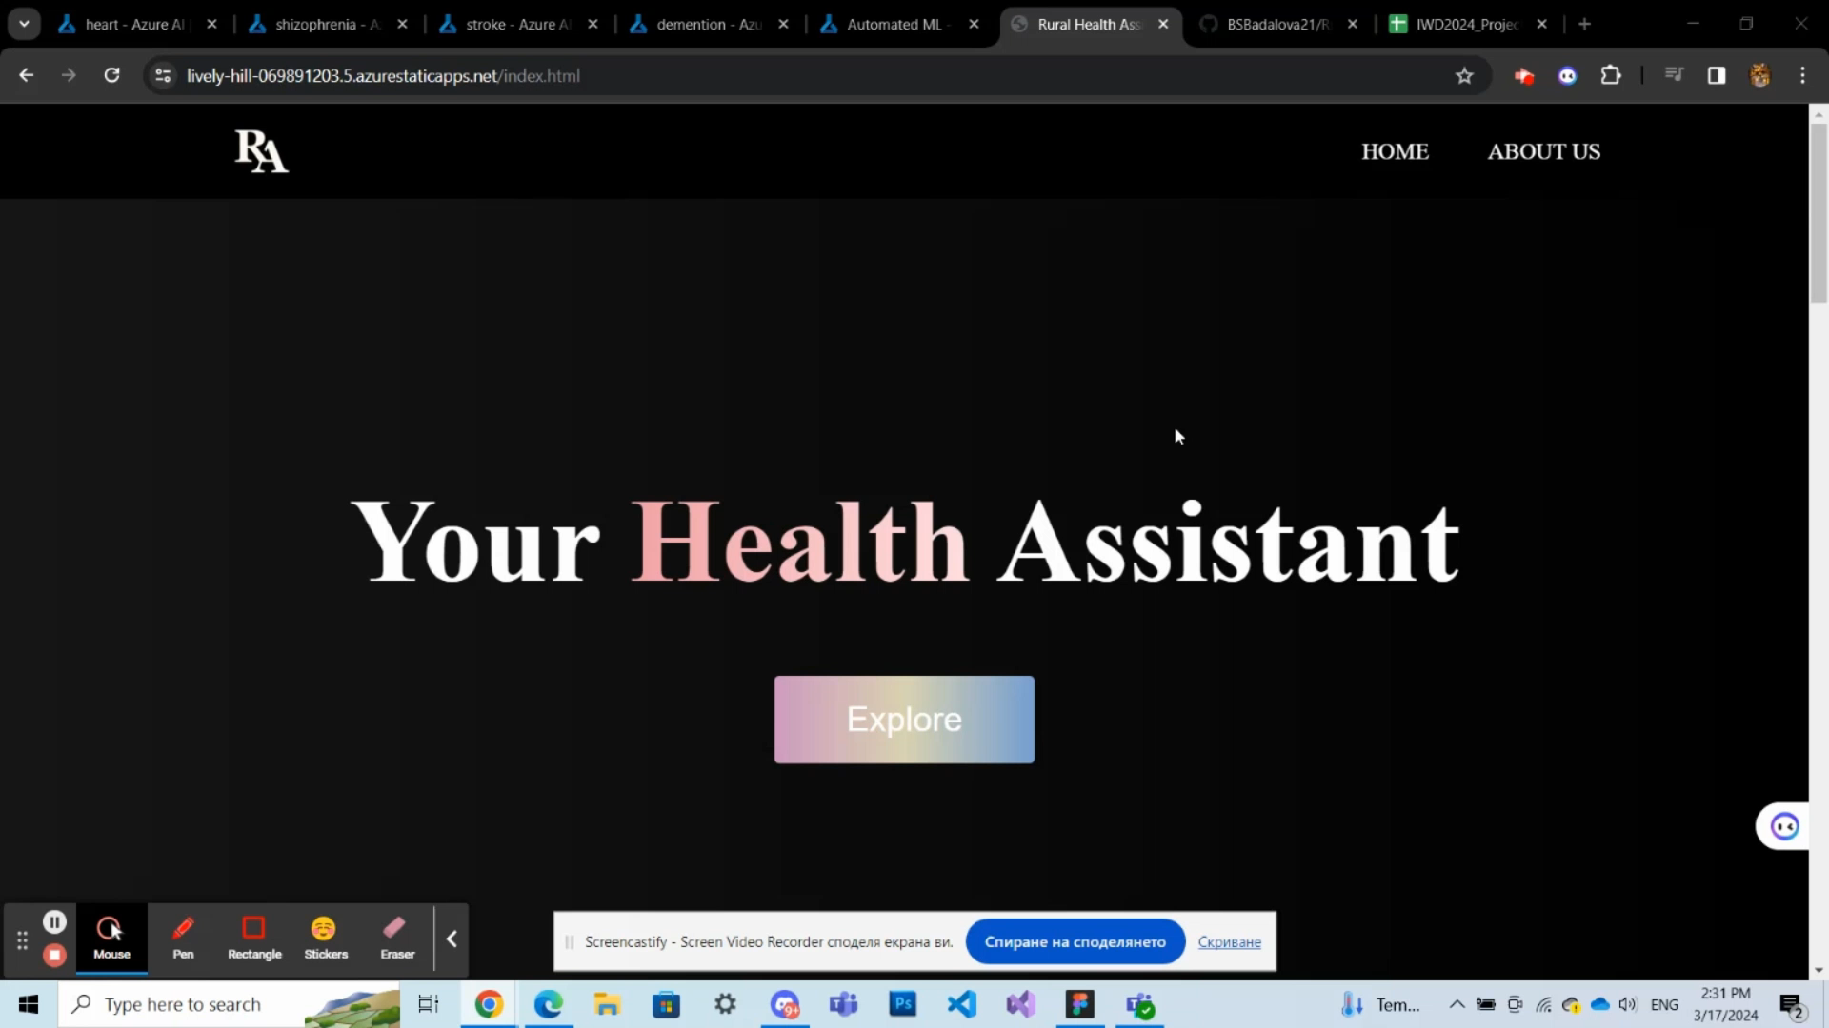

Slide 8
Resources
WorldBank
Kaagle

Slide 9
Thank you for your attention!
2022

